Slide 1
CNN Accelerator Implementation Plan

Slide 2
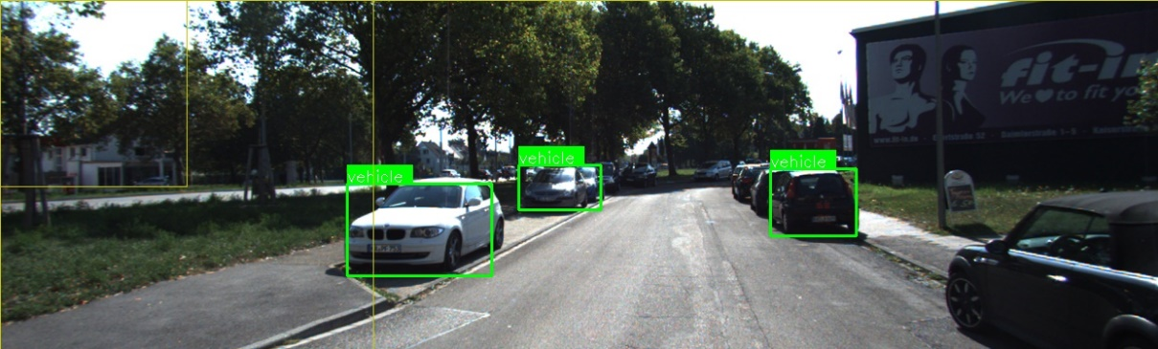
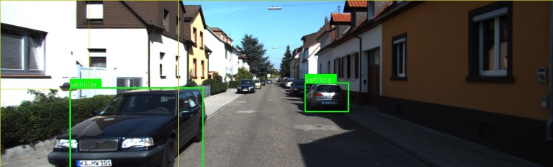
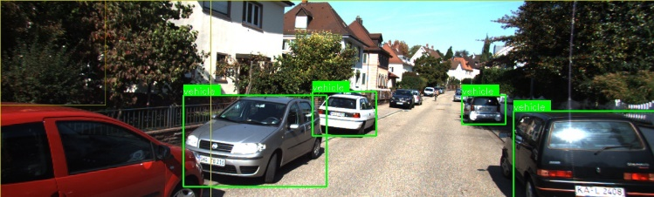
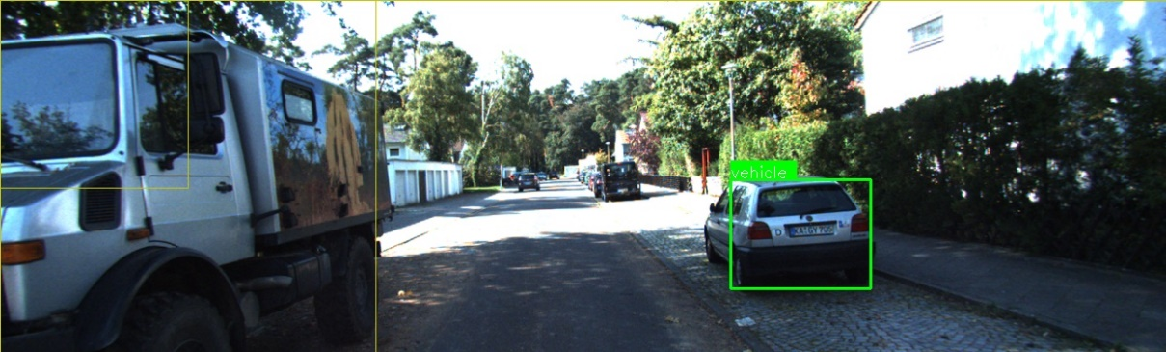
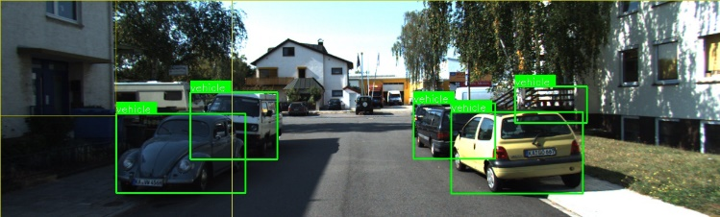
CNN Acceleration

Slide 3
System Architecture

Slide 4
CNN Layer Attributes
Kernel-Width {Wide, Narrow}
Describes the relative width ‘KW’ of a single kernel
Also corresponds to input map width
Narrow: ‘KW’ =< 8
Wide: ‘KW’ > 8
Layer-Width {Wide, Narrow}
Describes the relative width ‘LW’ of a layer
Narrow: ‘LW’ =< 8
Wide: ‘LW’ > 8

Slide 5
CNN Layer Attributes (cont.)
Pooling
Specifies whether the layer includes a pooling stage
Pooling subsamples a 2D window from a convolved input map
The subsampling operation can be min, max, average, etc.
The stride of the subsampling window determines the dimension of pooling output map
Example: the result of convolving a 256x256x3 input with a 3x3x3 kernel is a 256x256x1 map (ignoring boundary effects). Passing this map to a MAX pooling operator with 2x2 stride results in a 128x128x1 map. Each pixel in this map corresponds to the max value in the convolved map at window centered at the pixel

Slide 6
CNN Layer Attributes (cont.)
Activation
Specifies whether the layer includes an activation stage
Activation transforms each input map pixel according to f(x)
Activation does not alter the dimensions of the input map
The implementation of Activation is relatively cheap when f(x) =
Rectified Linear (ReLU)
Activation may require LUT based interpolation when f(x) =
Sigmoid
Hyperbolic tangent
Other differentiable functions of ‘x’

Slide 7
CNN Layer Attributes (cont.)
Squeeze
Specifies whether the layer implements a map reducing “Squeeze” operation
Squeezing a layer reduces the width of the output map leaving the layer
The width of an output map is equal to the number of kernels in the layer
By performing a convolution across the original K output maps, a single final output map is produced
Note that there may be several (SQ) Squeeze kernels, each producing a single output map
Generally |SQ| << K
Typically the squeeze kernel is a 1x1 but is not necessary
Stretch (Expand)
Specifies whether the layer implements a map increasing “Stretch” operation
Stretching a layer increases the width of the output map leaving the layer
Operation is identical to “Squeeze” however the number of Stretch (ST) kernels follows: |ST| > K
Typically the stretch kernel is a 1x1 but is not necessary

Slide 8
Accelerating a Single Kernel

Slide 9
Single Convolution Engine
Single Engine capable of performing:
3x3x1 convolution (CPI = 0.9)
1x1x10 convolution (CPI = 1.0)
Uses optimized DSP48E2 tile architecture consisting of two DSP48E2 macros
Operates at 5x datapath clock- (500Mhz)
Requires pixels to be evenly distributed across row-buffer banks
A single row buffer bank consists of two row buffers of max length = L. A row buffer bank has a dedicated connection to an adjacent DSP48E2 unit in the enclosing DSP48E2 tile
DSP48E2 Tile

Slide 10
Adaptive Window Engine (AWE)
Dual convolution engines capable of performing the following:
3x3x2 (CPI = 0.9)
5x5x1 (CPI = 1.25)
1x1x20 (CPI = 1.0)
Support 3x3 or 5x5 pooling
Requires pixels to be evenly distributed across row-buffer banks
In pooling mode the row-buffers feed a MAX/MIN/AVG module. Pooling can be performed over the two row buffers of a single engine or over the four combined row-buffers of two engines.

Slide 11
Load Balancing in AWE
To minimize logic delay, each buffer is directly connected to the adjacent DSP48 in the tile.
Since we are overclocking to reduce resource utilization of DSP48, it is important that each DSP48 as nearly equal work
Row renaming is accomplished by (1) reordering of weights based on the current row we operating on, and (2) a specific matriculation of rows across the buffers
In the case of odd kernels, a duplicate of one row is required in the buffer
Dual
Row Buffers
Dual
Row Buffers
BRAM0
BRAM1
BRAM2
BRAM3
Row Matriculation for 3x3 Config

Slide 12
Load Balancing in AWE
Row Matriculation for 5x5 Config

Slide 14
Row Buffer Logic
Supports up to 512 x 512 images
BRAMS are 1024 elements deep
Each Convolution Engines use 2 dual ported (one port for reading, another port to write while reading for row matriculation) 1024 element BRAM’s as row buffers; Each BRAM is partitioned into 512 chunks, to support up to 4 rows
Switching to different partitions on different row combinations is accomplished by toggling MSB, gray code counter, and OR’ing the LSB with a parity bit
Convolution engines start 1 cycle after each other

Slide 15
MSB
LSB
BRAM0
Addr Bits
0 | . | . | . | . | . | . | . | . | . | . | . | . | 0 | 0
0
Preloaded Sequence
0 2 512 513 514
MSB
LSB
BRAM1
Addr Bits
0 | . | . | . | . | . | . | . | . | . | . | . | . | 0 | 1
1
OR
0 1 2 N
0 1 2 N
Image
1023
512
511
0
BRAM0
Row 0
X
Row 1
BRAM1
Row 1
Row 0
X
Cycle 0

Slide 16
MSB
LSB
BRAM0
Addr Bits
0 | . | . | . | . | . | . | . | . | . | . | . | . | 0 | 0
2
Preloaded Sequence
0 2 512 513 514
MSB
LSB
BRAM1
Addr Bits
0 | . | . | . | . | . | . | . | . | . | . | . | . | X | X
X
Weight Value of 0 Needed here
0 1 2 N
0 1 2 N
Image
1023
512
511
0
BRAM0
Row 2
Row 0
X
Row 2
Row 0
Row 1
BRAM1
Row 1
Row 0
X
Cycle 1

Slide 17
MSB
LSB
BRAM0
Addr Bits
1 | . | . | . | . | . | . | . | . | . | . | . | . | 0 | 0
512
Preloaded Sequence
0 2 512 513 514
MSB
LSB
BRAM1
Addr Bits
1 | . | . | . | . | . | . | . | . | . | . | . | . | 0 | 0
512
0 1 2 N
0 1 2 N
Image
1023
512
511
0
BRAM0
Row 0
X
Row 2
Row 1
BRAM1
Row 1
Row 0
X
Cycle 2

Slide 18
MSB
LSB
BRAM0
Addr Bits
1 | . | . | . | . | . | . | . | . | . | . | . | . | 0 | 0
513
Preloaded Sequence
0 2 512 513 514
MSB
LSB
BRAM1
Addr Bits
1 | . | . | . | . | . | . | . | . | . | . | . | . | 0 | 0
513
0 1 2 N
0 1 2 N
Image
1023
512
511
0
BRAM0
Row 0
X
Row 2
Row 1
BRAM1
Row 1
Row 0
X
Cycle 3

Slide 19
MSB
LSB
BRAM0
Addr Bits
1 | . | . | . | . | . | . | . | . | . | . | . | . | 0 | 0
514
Preloaded Sequence
0 2 512 513 514
MSB
LSB
BRAM1
Addr Bits
1 | . | . | . | . | . | . | . | . | . | . | . | . | 0 | 0
514
0 1 2 N
0 1 2 N
Image
1023
512
511
0
BRAM0
Row 0
X
Row 2
Row 1
Row 0
BRAM1
Row 1
Row 0
X
Cycle 4

Slide 20
Weight Table logic
1 dual ported weight table per convolution engine
Weights are supplied from both ports

Slide 21
Weight Table logic (3x3)
0 1 2
0 1 2
0 | 1 | 2 | 3 | 4 | 5 | 6 | 7 | 8 | 9

Slide 22
Adaptive Window Quad
Four cascaded Adaptive Window Engines (AWE)
Quad shares a single bidirectional Tile Router port
Supports Narrow Convolution or wide Pooling
Routable output for the following:
3x3x8, 5x5x4, or 1x1x80 convolutions plus optional activation and pooling
8-3x3 pooling or 4-5x5 pooling

Slide 23
Accelerating Wide Kernels
AW Quad Cascade Path
Adaptive Window Quads can be cascaded at the output/input of the top/bottom quads respectively
Quads are asynchronous wrt. each other requiring shallow buffering at the interface

Slide 24
Accelerating Multiple Kernels (Wide Layers)

Slide 25
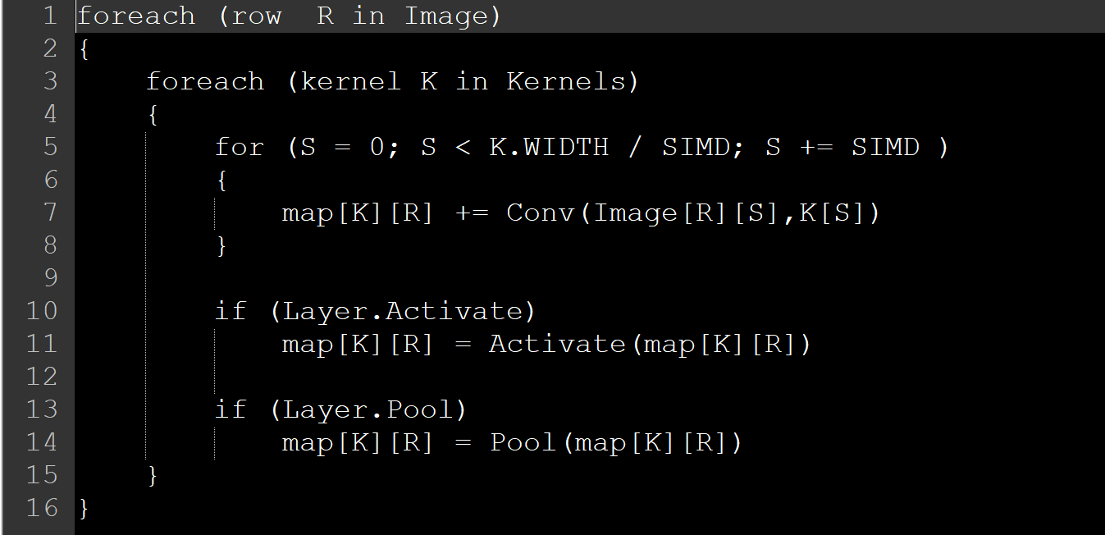
Accelerating multiple Kernels
Make full use of current row buffer contents across all kernels
Since kernels share identical input maps (different kernel weights)
Reduces demand on Input interface particularly for Wide Layers

Slide 26
Fetch-Aggregate-Store (FAS) Unit
The FAS unit is responsible for:
fetching data and forwarding to one or more AWP
Accumulating the partial maps arriving from multiple AWPs and/or memory
Storing maps to memory in particular format
Each FAS has two dedicated SOC-IT interfaces for I/O
It is possible for FAS to share its I/O bandwidth with other FAS in a “teaming” configuration (advanced)
From the software perspective, a FAS represents a CNN accelerator
Application software acquires a resource lock on a FAS for the duration of a CNN compute
Software invokes the FAS which in turn dispatches work to AWP at a per layer granularity

Slide 27
Fetch-Aggregate-Store (FAS) Unit

Slide 28
Single Adaptive Window Processor
Kintex Ultrascale

Slide 29
Implementation Roles
AWP – Ikenna & Geetha
FAS – Saambhavi
Functional Verification – Kevin & Ikenna
Software development – Kevin

Slide 30
Depth x NumRows x NumCols
Map size : 8x20x20
Kernel size 5x8x3x3
Stride is 1
No padding
Ideally output will be 5x18x18;
However output is be 5x19x20, with the result in the top left
[R0C0D0, R0C1D0, ... R0C19D0] [R0C0D1, R0C1D1, ... R0C19D1] ….... [R0C0D4, R0C1D4, ... R0C19D4]
[R1C0D0, R1C1D0, ... R1C19D0] [R1C0D1, R1C1D1, ... R1C19D1] ….... [R1C0D4, R1C1D4, ... R1C19D4]

